Slide 1
Multiscale cardiovascular modelling
VITAL Training School 2 – 12th February, 2026
Lecturer: Dr Gonzalo Maso Talou

Slide 2
Content
Introduction to multiscale modelling
Representative volume elements (RVEs)
Statistical volume element
RVE size and implications
Scales coupling
Insertion
Homogenisation
Multiscale in cardiovascular modelling

Slide 3
Why?
Black box macro constitutive laws
Material design
Understanding scale effects
Accounting for material heterogeneity
Multi-physics coupling across scales (key in biology)

Slide 4
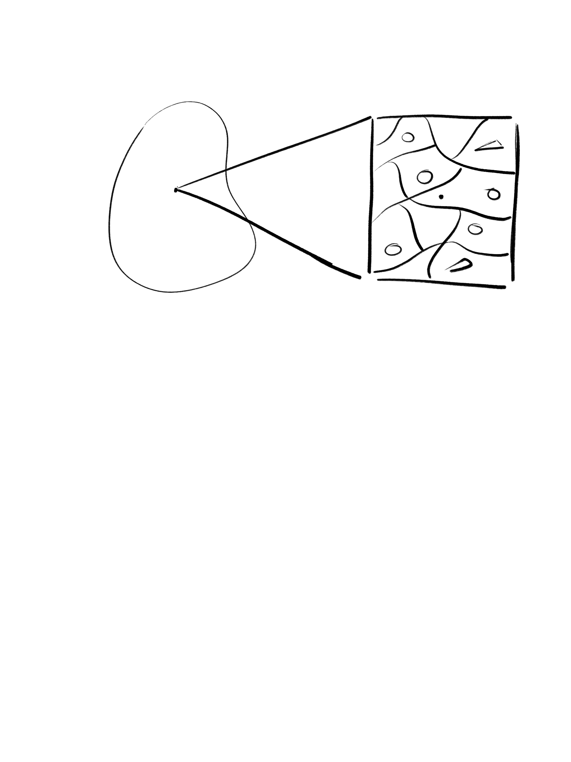
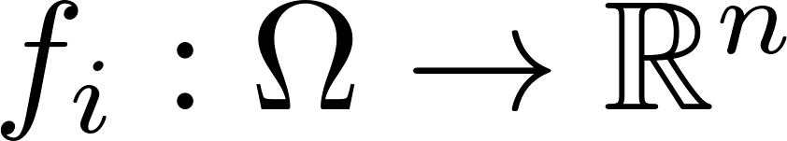
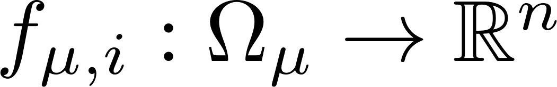

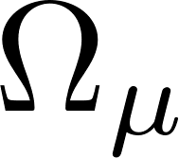

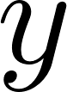
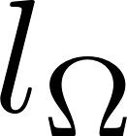
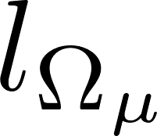
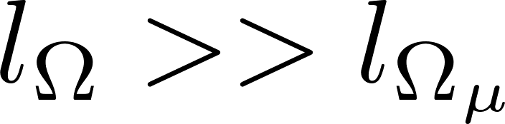
Multiscale modelling
Macroscale model
Microscale model
Macroscale equilibrium equations
Macroscale equilibrium equations

Slide 5
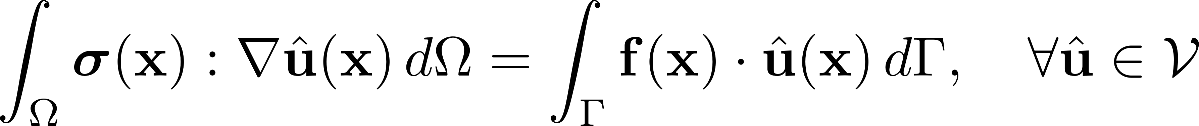
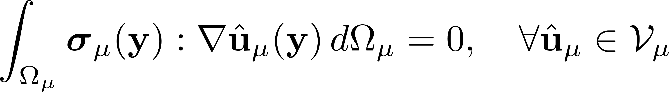
Multiscale modelling (solid mechanics example)
Macroscale model
Microscale model

Slide 6
Multiscale modelling
Macroscale model
Microscale model
Insertion
Macroscale equilibrium equations
Homogenisation
Macroscale equilibrium equations

Slide 7
Multiscale modelling
Macroscale model
Microscale model
Insertion
Macroscale equilibrium equations
Homogenisation
Macroscale equilibrium equations
Representative Volume Element (RVE)

Slide 8
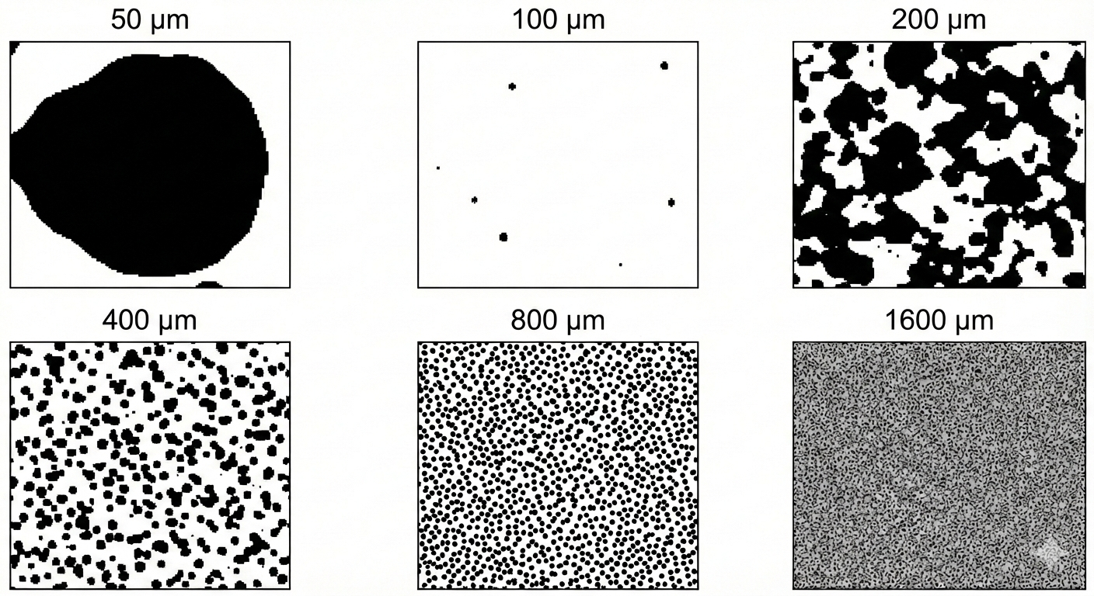
Representative volume element (RVE)
The microscale enables a mechanistic description of constitutive laws and model parameters;
Allows the characterisation of uncertainties related to microscopic heterogeneities;
Allows to introduce heterogeneity descriptors in the “constitutive law”.
Example of candidates for RVE in a
composite material
Kanit, T., Forest, S., Galliet, I., Mounoury, V. and Jeulin, D., 2003. Determination of the size of the representative volume element for random composites: statistical and numerical approach. International Journal of solids and structures.
Notes:
Analogous to the continuum hypothesis in fluid dynamics.
The continuum hypothesis treats fluids as continuous matter rather than discrete molecules, allowing properties like density and velocity to be defined at any point as spatial averages. It assumes that a fluid's microscopic, particulate nature is negligible at a macroscopic scale where volumes are small yet contain enough molecules to avoid random statistical fluctuations.

Slide 9
Representative volume element (RVE)
How big the RVE needs to be?
Problem and quantity dependent;
Multiple statistical volume element realisations (i.e. samples of microscale domains) at each RVE size can guide the choice (Kanit 2003).
Example of candidates for RVE in a
composite material
Kanit, T., Forest, S., Galliet, I., Mounoury, V. and Jeulin, D., 2003. Determination of the size of the representative volume element for random composites: statistical and numerical approach. International Journal of solids and structures.
Notes:
Analogous to the continuum hypothesis in fluid dynamics.
The continuum hypothesis treats fluids as continuous matter rather than discrete molecules, allowing properties like density and velocity to be defined at any point as spatial averages. It assumes that a fluid's microscopic, particulate nature is negligible at a macroscopic scale where volumes are small yet contain enough molecules to avoid random statistical fluctuations.

Slide 10
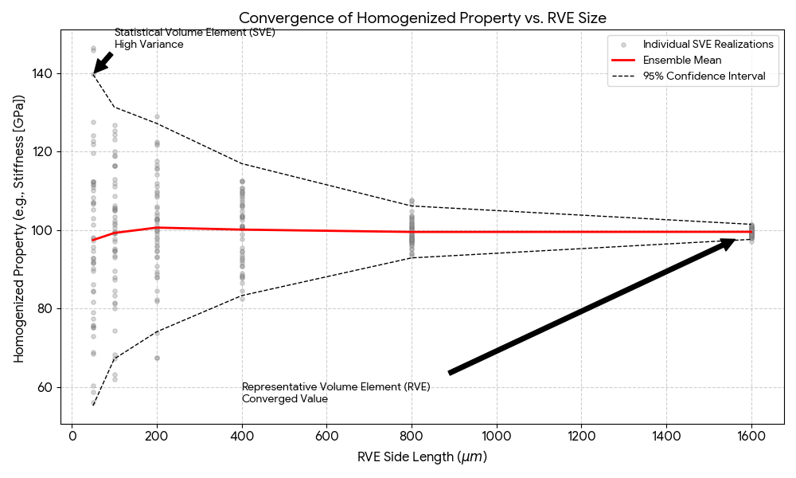
Representative volume element (RVE)
If the microscale is too small, the homogenised property presents large variation (not converged);
If the microscale is too big, solving the realisation has an unnecessary high computational cost.
Notes:
Analogous to the continuum hypothesis in fluid dynamics.
The continuum hypothesis treats fluids as continuous matter rather than discrete molecules, allowing properties like density and velocity to be defined at any point as spatial averages. It assumes that a fluid's microscopic, particulate nature is negligible at a macroscopic scale where volumes are small yet contain enough molecules to avoid random statistical fluctuations.

Slide 11
Insertion
Process by which macroscale kinematics constrains the microscale model;
Impacts boundary conditions;
In some cases, macroscopic kinematics affect microscale heterogeneity or properties of the configuration.
Macroscale
Insertion
Microscale

Slide 12
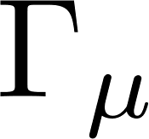
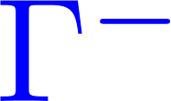
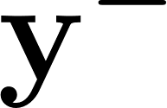
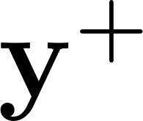
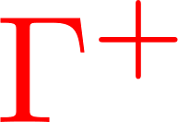
Insertion (solid mechanics example)
Microscale domain
Macroscopic strains define microscopic boundary conditions
Option 1:linear boundary displacements,
Option 2: periodic boundary conditions,
Macroscale quantities
General admissible kinematic constraints DeSouza 2015
De Souza Neto, E.A., Blanco, P.J., Sánchez, P.J. and Feijóo, R.A., 2015. An RVE-based multiscale theory of solids with micro-scale inertia and body force effects. Mechanics of Materials.
Notes:
linear boundary displacements assumes rigid boundaries, upper boundary/stiffer estimate of the material properties.

Slide 13
Homogenisation
After solving the RVE equilibrium, solution from the microscale field of interest is reduced to a single output for the macroscale model;
The reduction operation must be carefully chosen depending on the application;
Macroscale
Homogenisation
Microscale

Slide 14
Homogenisation
For RVEs (“converged” response), an average operation is the frequent choice;
The principle of multiscale virtual power allows to rationally derive a homogenisation strategy based on the conservation of total virtual power across scales (Blanco 2016).
Macroscale
Homogenisation
Microscale
Blanco, P.J., Sánchez, P.J., de Souza Neto, E.A. and Feijóo, R.A., 2016. Variational foundations and generalized unified theory of RVE-based multiscale models. Archives of Computational Methods in Engineering.

Slide 15
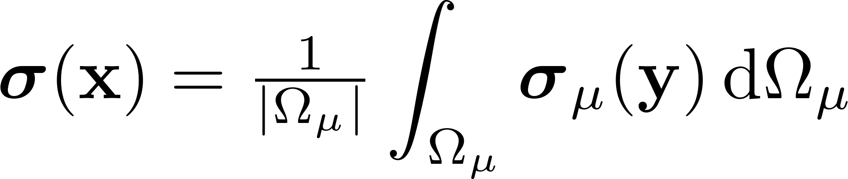
Homogenisation (solid mechanics example)
Macroscopic stress tensor at a given point x, is computed from the associated RVE as
Macroscale
Homogenisation
Microscale

Slide 16
Use case 1: Direct multiscale model cycle
Evaluation of material dependent internal or external efforts or microscale dependent parameters
Macroscale
Macroscale
Evaluation of macroscale equilibrium
Insertion
Homogenisation
Homogenised values for internal or external efforts or microscale dependent parameters
RVE Equilibrium
Microscale
Microscale

Slide 17
Use case 2: Surrogate microscale cycle
Offline
Macroscale
Macroscale
Train a microscale surrogate model to learn the homogenised response within the physiological ranges at the macroscale.
Insertion
Homogenisation
Microscale
RVE Equilibrium
Microscale
Online
Evaluation of macroscale equilibrium
Evaluation of material dependent internal or external efforts or microscale dependent parameters
Evaluation of microscale surrogate model
Homogenised values for internal or external efforts or microscale dependent parameters

Slide 18
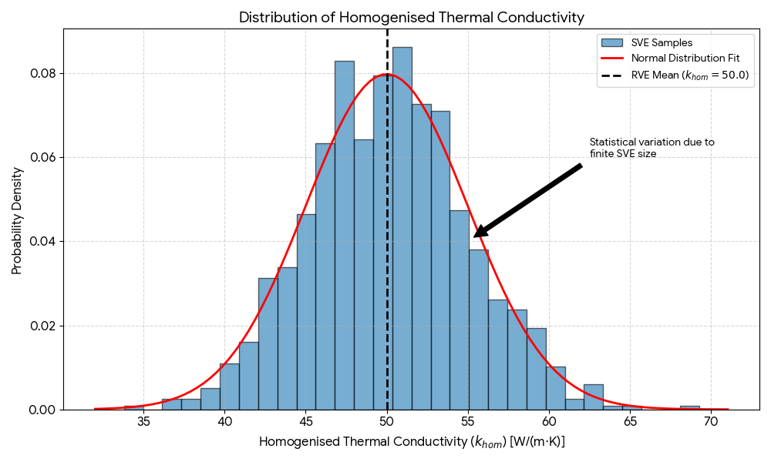
Use case 3: Microscale uncertainty cycle
Evaluation of material dependent internal or external efforts or microscale dependent parameters
Evaluation of macroscale equilibrium
Macroscale
Macroscale
Macroscale
Macroscale
Macroscale
Macroscale
Macroscale
Macroscale
Insertion
Macroscale
Homogenisation
Macroscale
Insertion
Macroscale
Homogenisation
Macroscale
Insertion
Homogenisation
Insertion
Homogenisation
Insertion
Homogenisation
SVE Equilibrium
Microscale
Insertion
Microscale
Homogenisation
Microscale
SVE Equilibrium
Microscale
Distributions for internal or external efforts or microscale dependent parameters
Microscale
SVE Equilibrium
Microscale
Microscale
SVE Equilibrium
Microscale
Microscale
SVE Equilibrium
Microscale
Microscale
SVE Equilibrium
Microscale

Slide 19
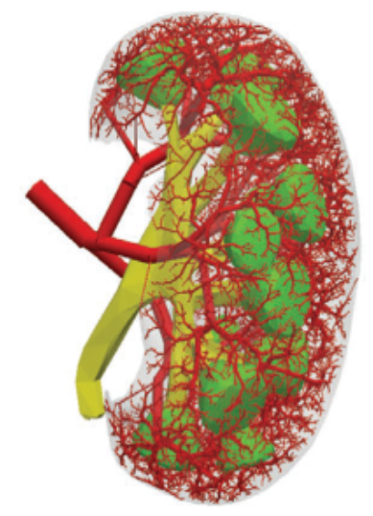
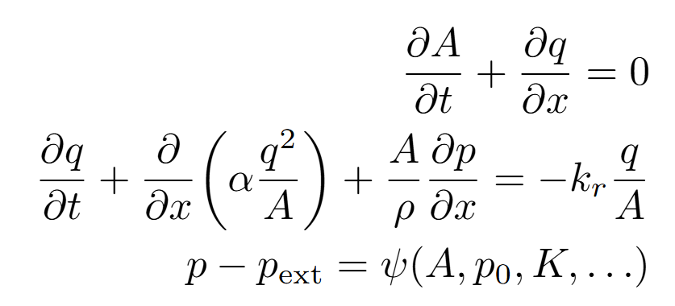
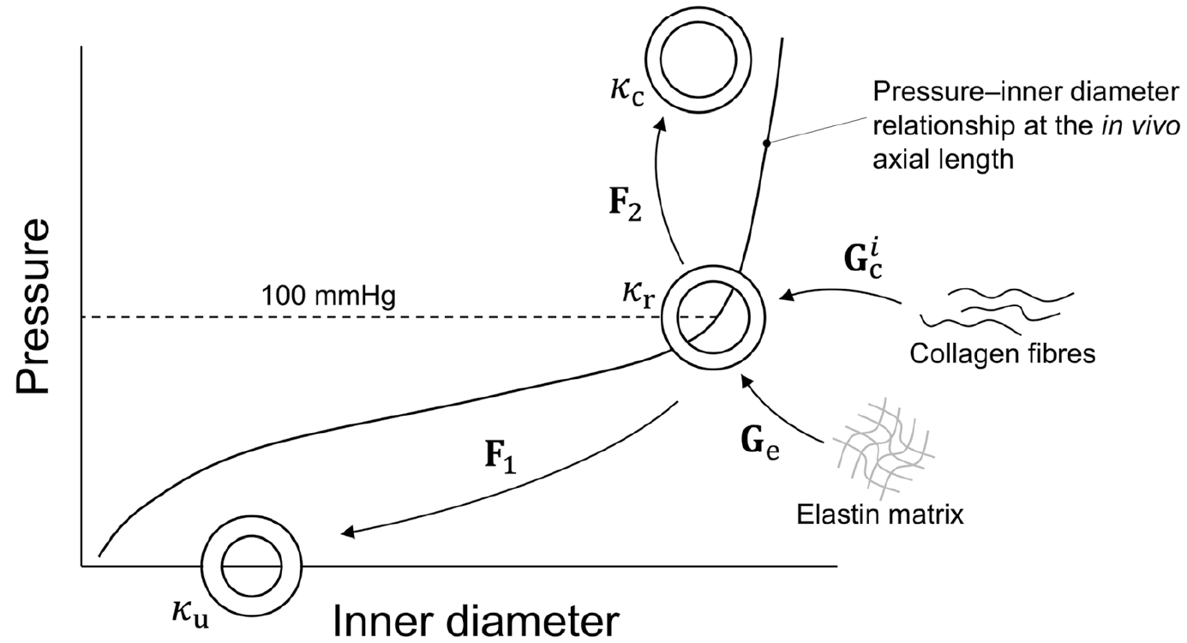
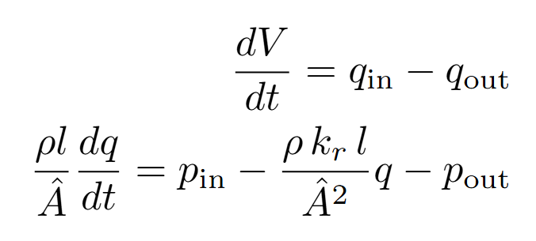
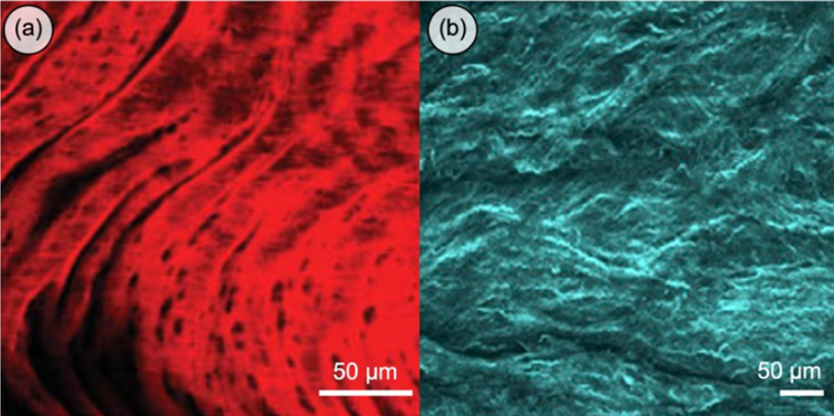
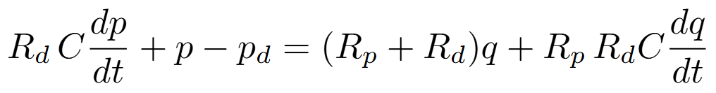
Multiscale cardiovascular modelling
K: material property related to vascular stiffness discussed by Alessandro Guidici.
1D vascular model (A, q, p)
0D vascular model
0D terminal model
Microscale: (Left) Elastin and (Right) collagen from Tornifoglio 2025
Tornifoglio, B., Hughes, C., Digeronimo, F., Guendouz, Y., Johnston, R.D. and Lally, C., 2025. Imaging the microstructure of the arterial wall–ex vivo to in vivo potential. Acta Biomaterialia.

Slide 20
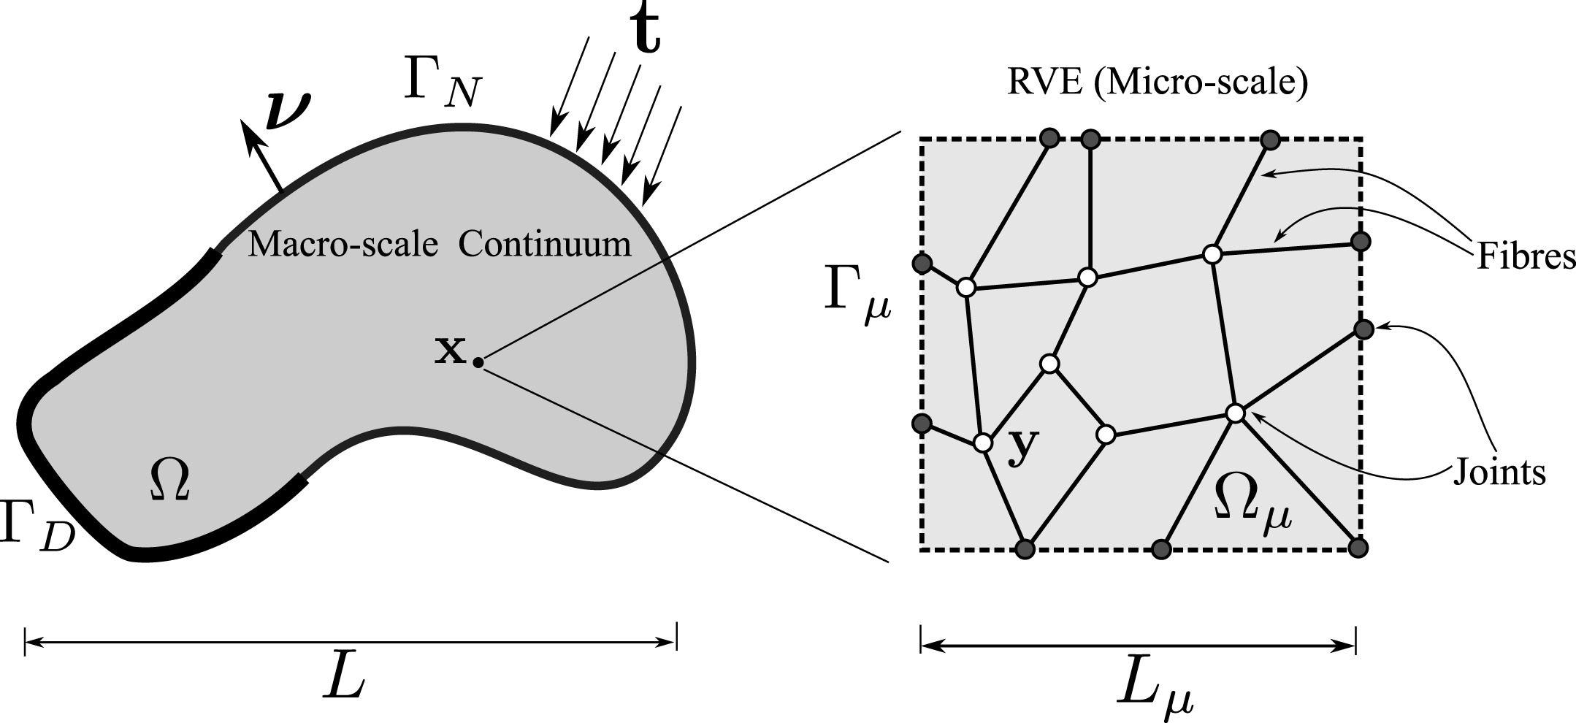
Multiscale cardiovascular modelling
K: material property related to vascular stiffness discussed by Alessandro Guidici.
1D vascular model (A, q, p)
0D vascular model
Multi-scale modelling of arterial tissue (Rocha et al. 2018)
0D terminal model
Rocha, F.F., Blanco, P.J., Sánchez, P.J. and Feijóo, R.A., 2018. Multi-scale modelling of arterial tissue: Linking networks of fibres to continua. Computer Methods in Applied Mechanics and Engineering.

Slide 21
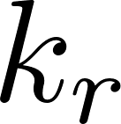
Multiscale cardiovascular modelling
1D vascular model (A, q, p)
1D microvascular model (A, q, p)
0D vascular model
Viscosity depends on the vessel radius (Fåhræus–Lindqvist effect), and plasma skimming occurs at bifurcations (see Possenti 2021).
0D terminal model
Possenti, L., Cicchetti, A., Rosati, R., Cerroni, D., Costantino, M.L., Rancati, T. and Zunino, P., 2021. A mesoscale computational model for microvascular oxygen transfer. Annals of Biomedical Engineering.

Slide 22
Multiscale cardiovascular modelling
1D vascular model (A, q, p)
1D microvascular model (A, q, p)
0D vascular model
Viscosity depends on the vessel radius (Fåhræus–Lindqvist effect), and plasma skimming occurs at bifurcations (see Possenti 2021).
0D terminal model
Possenti, L., Cicchetti, A., Rosati, R., Cerroni, D., Costantino, M.L., Rancati, T. and Zunino, P., 2021. A mesoscale computational model for microvascular oxygen transfer. Annals of Biomedical Engineering.

Slide 23
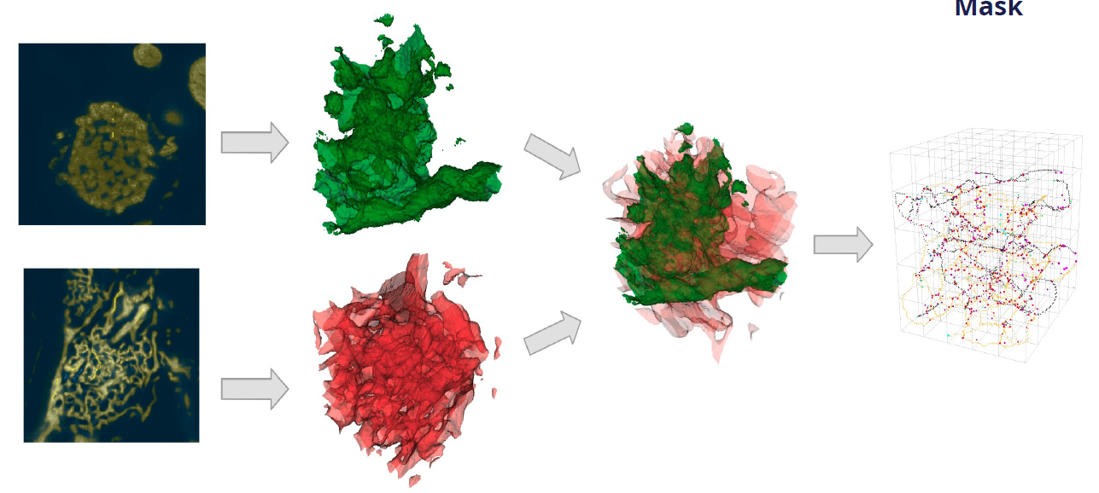
Multiscale cardiovascular modelling
R_{d}: Distal resistance to the terminal.
1D vascular model (A, q, p)
Experimental
imaging
Capillary network
0D vascular model
0D terminal model
Experimental data, as discussed by Harvey Davis, or in-silico generative tools (e.g. Maso Talou et al. 2021) can be used alongside 0D or 1D hemodynamic models.
Maso Talou, G.D., Safaei, S., Hunter, P.J. and Blanco, P.J., 2021. Adaptive constrained constructive optimisation for complex vascularisation processes. Scientific Reports.

Slide 24
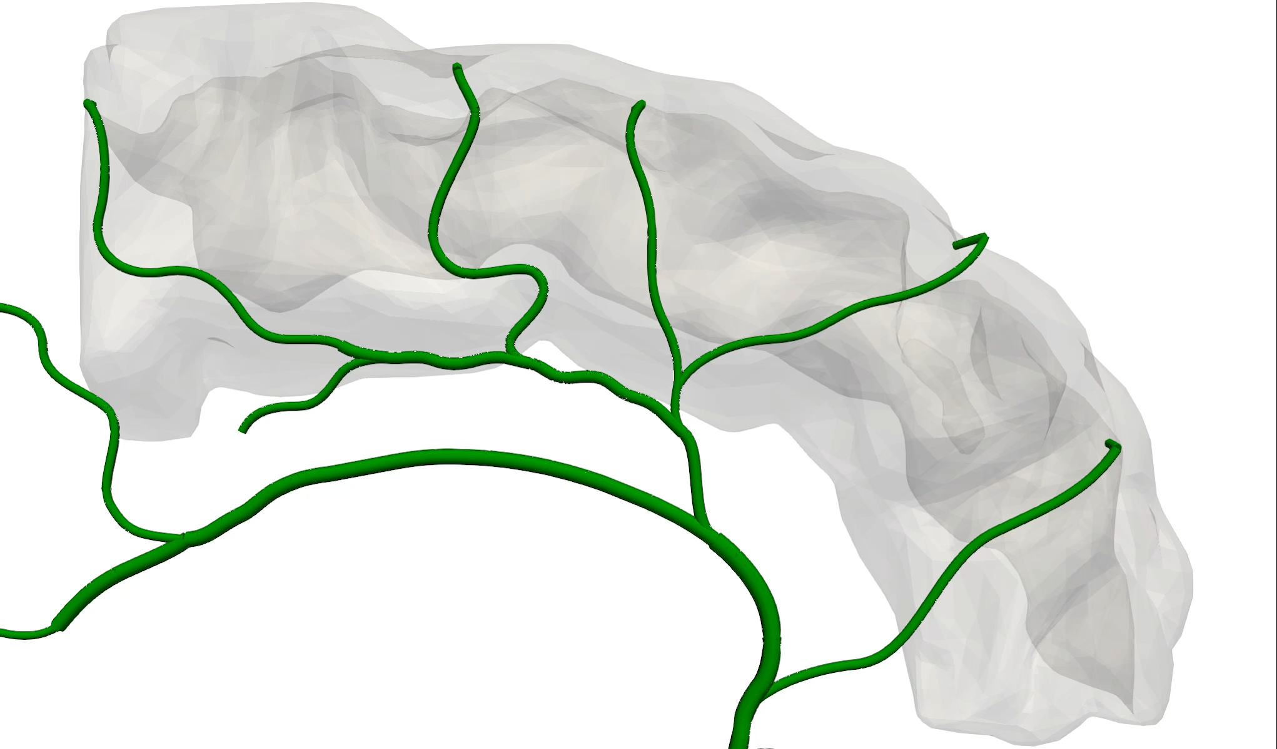
Multiscale cardiovascular modelling
R_{d}: Distal resistance to the terminal.
1D vascular model (A, q, p)
0D vascular model
0D terminal model
Experimental data, as discussed by Harvey Davis, or in-silico generative tools (e.g. Maso Talou et al. 2021) can be used alongside 0D or 1D hemodynamic models for capillary hemodynamics.
Maso Talou, G.D., Safaei, S., Hunter, P.J. and Blanco, P.J., 2021. Adaptive constrained constructive optimisation for complex vascularisation processes. Scientific Reports.

Slide 25
Multiscale cardiovascular modelling
Tutorial task
R_{d}: Distal resistance to the terminal.
1D vascular model (A, q, p)
0D vascular model
0D terminal model
Experimental data, as discussed by Harvey Davis, or in-silico generative tools (e.g. Maso Talou et al. 2021) can be used alongside 0D or 1D hemodynamic models for capillary hemodynamics.
Maso Talou, G.D., Safaei, S., Hunter, P.J. and Blanco, P.J., 2021. Adaptive constrained constructive optimisation for complex vascularisation processes. Scientific Reports.

Slide 26
Multiscale cardiovascular modelling
1D vascular model (A, q, p)
Question: What do you think is the homogenisation strategy to map the resistances over the 1D microvascular network into R_{d}?
0D vascular model
0D terminal model
Maso Talou, G.D., Safaei, S., Hunter, P.J. and Blanco, P.J., 2021. Adaptive constrained constructive optimisation for complex vascularisation processes. Scientific Reports.

Slide 27
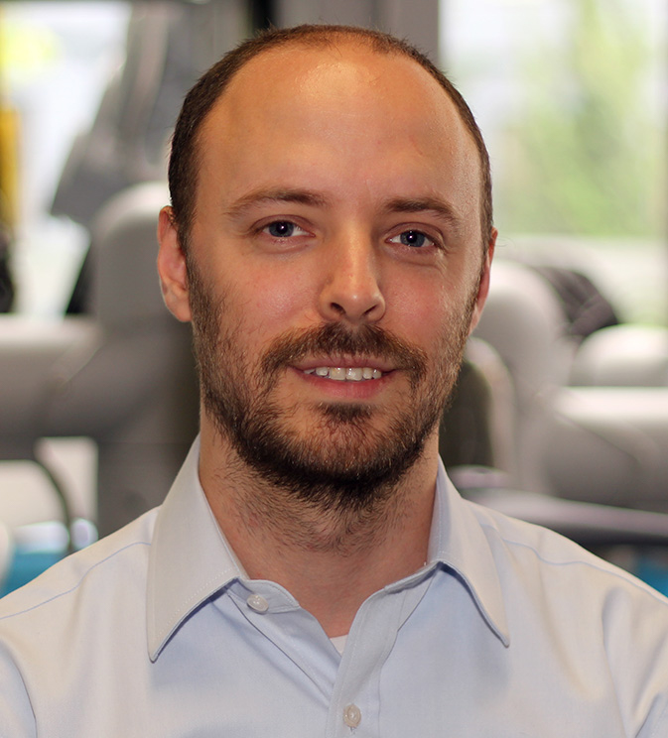


Contact us!
Questions?
Follow our research at
Gonzalo Maso Talou
Principal investigator at Animus Laboratory
g.masotalou@auckland.ac.nz
Notes:
Applications to dementia, diabetes and wellbeing

Slide 28
Contact us!
Coffee break!
Follow our research at
Gonzalo Maso Talou
Principal investigator at Animus Laboratory
g.masotalou@auckland.ac.nz
Notes:
Applications to dementia, diabetes and wellbeing

